Slide 1

XYZ Data Analysis
Siddharth Tandon

Slide 2

Univariate Analysis

Slide 3
Summary
Total Variables: 22
Number of observations: 14000
No duplicates
All the variables are discrete in nature
Target variable is balanced in dataset

Slide 4
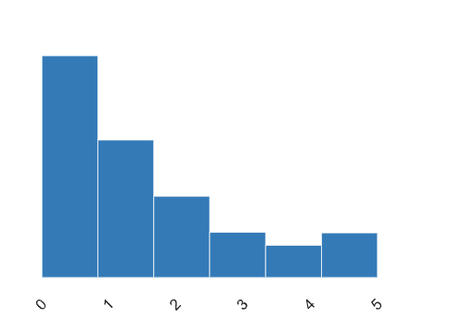
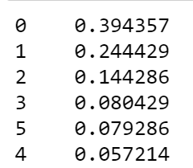
National Origin
Dataset shows that most of the employees are from 0,1, and 2 country code

Slide 5
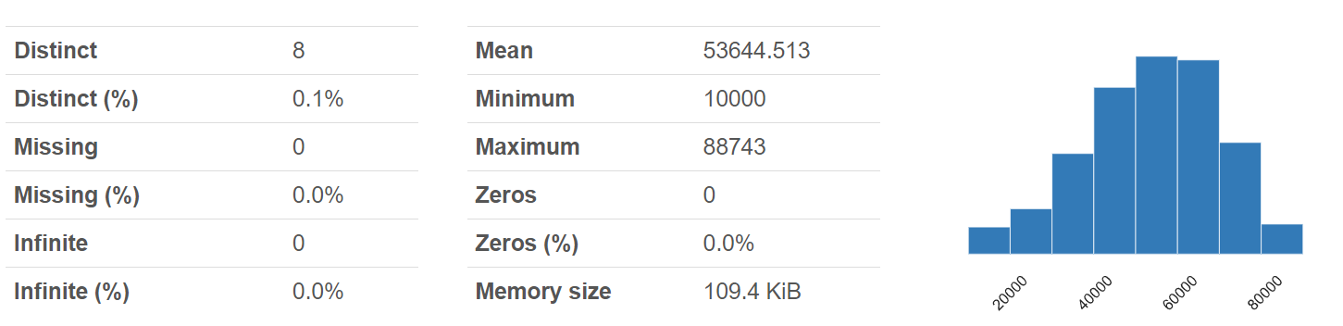
Recruiting method Code
More than 60% hiring is happening from 3 codes

Slide 6
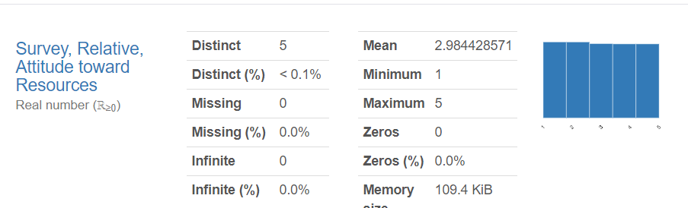
Survey, Relative, Attitude toward resources
Close to 50% Employees are not happy with the resources they have at there disposal

Slide 7
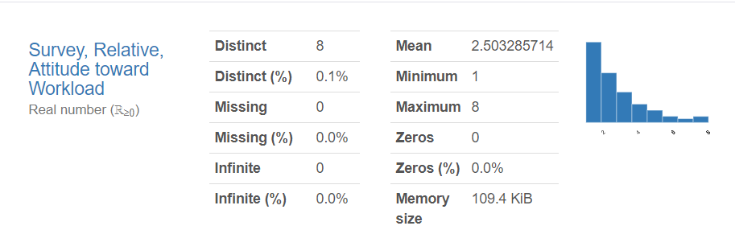
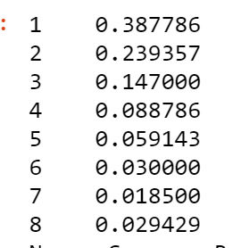
Survey, Relative, Attitude toward Workload
Close to 80% Employees are not happy with the work load

Slide 8
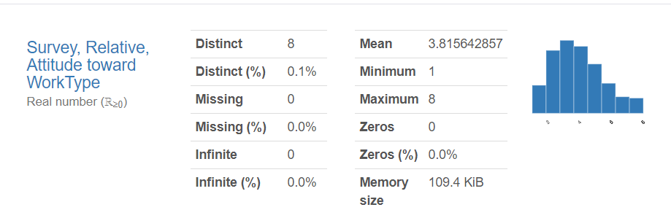
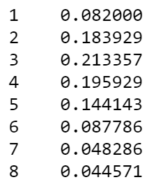
Survey, Relative, Attitude toward Work type
Close to 70% Employees are not happy with the type of work they are doing

Slide 9
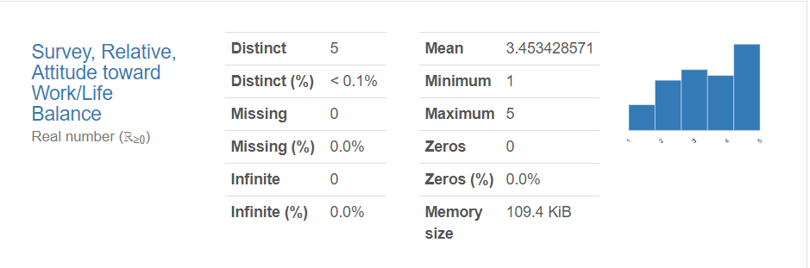
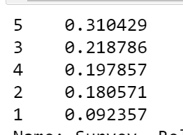
Survey, Relative, Attitude toward Work/life balance
Close to 30% employees feel that there is no work life balance in the company

Slide 10
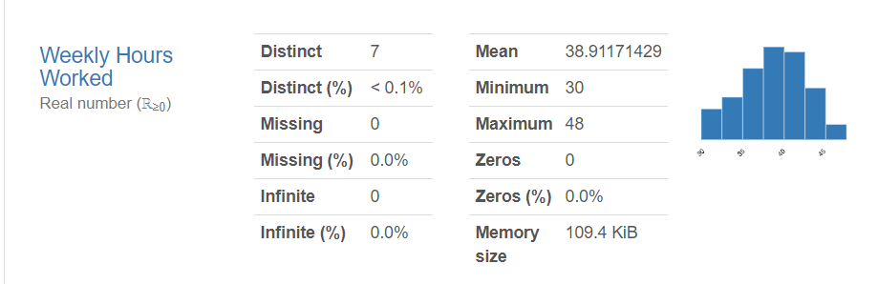
Weekly hours worked
On an average people are spending close to 40 hours

Slide 11
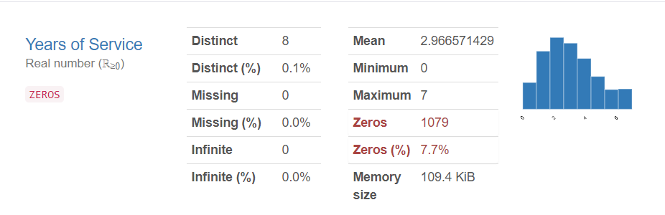
Years Of Service
On an average employees spend 3 years in the company

Slide 12
Bivariate Analysis

Slide 13
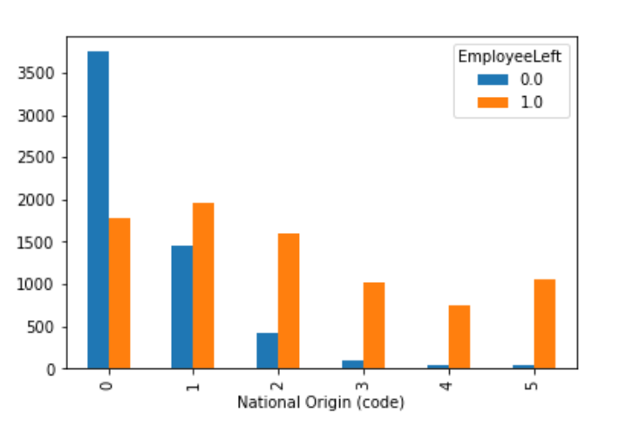
Nation Origin Code
Employees from certain countries are more prone towards attrition

Slide 14
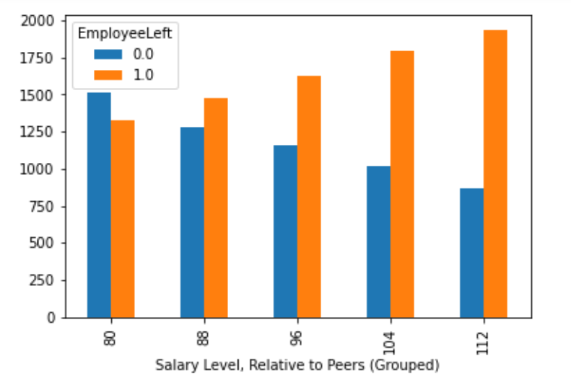
Salary Level, Relative to Peers (Grouped)
Dataset shows that as the difference in salary between peers increases so does the chances of him leaving the job

Slide 15
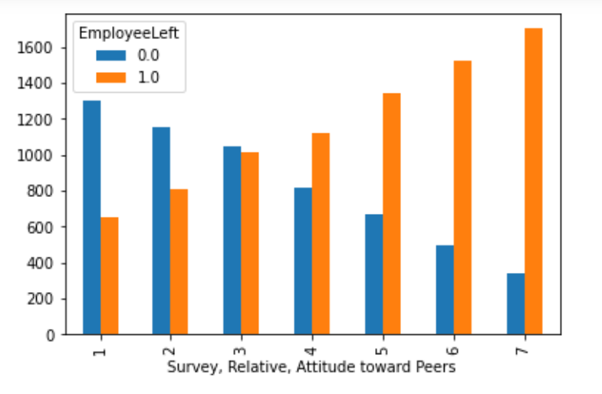
Survey Relative Attitude towards Peers
This feature is positively associated with attrition

Slide 16
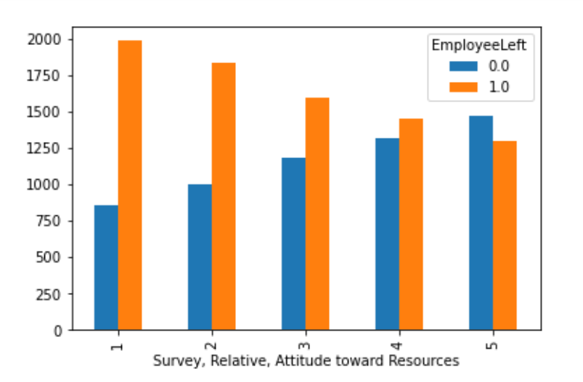
Survey, Relative, Attitude toward Resources
Some employees are of view that resources are of not good quality and prefer to join other company
Close to 50% employees feel that resources are of not good quality

Slide 17
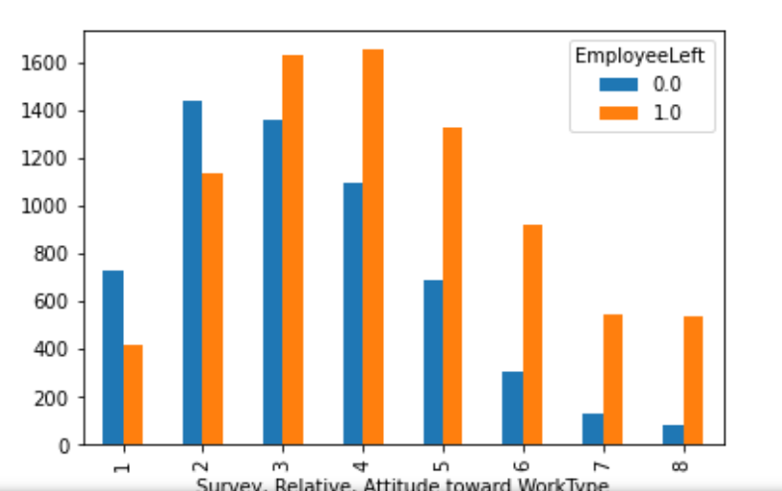
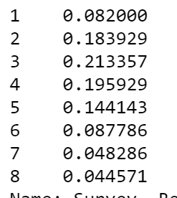
Survey Relative Attitude towards Work type
Looks like employees are not satisfied with the type of work they are doing

Slide 18
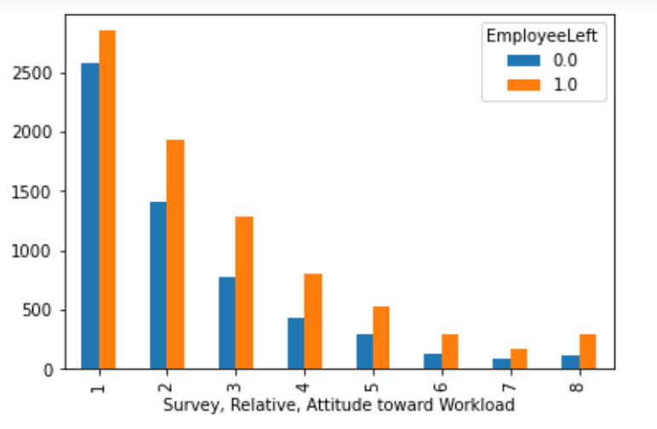
Survey Relative Attitude towards Workload
Employees feel the heat of workload

Slide 19
Modelling

Slide 20
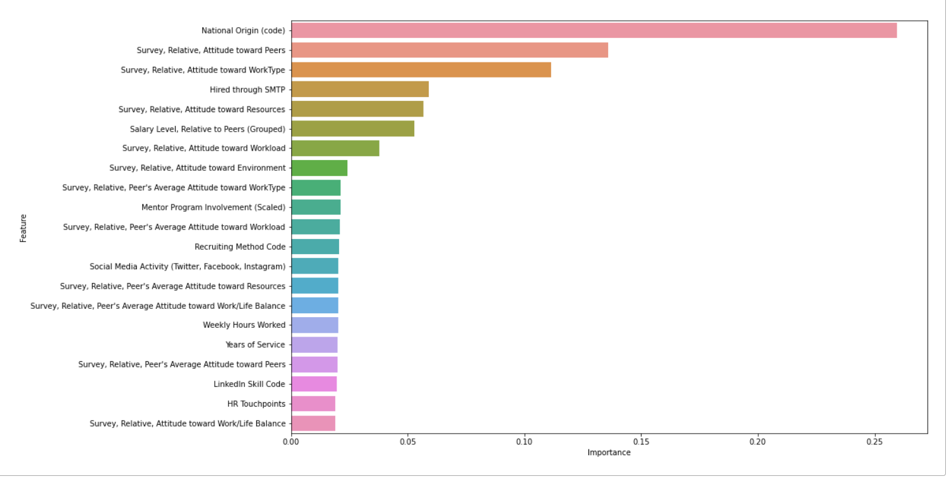
Model
Used xgboost model
Used accuracy as the target metric
Able to achieve 90% accuracy
Following features are important for the model

Slide 21
Deployment

Slide 22
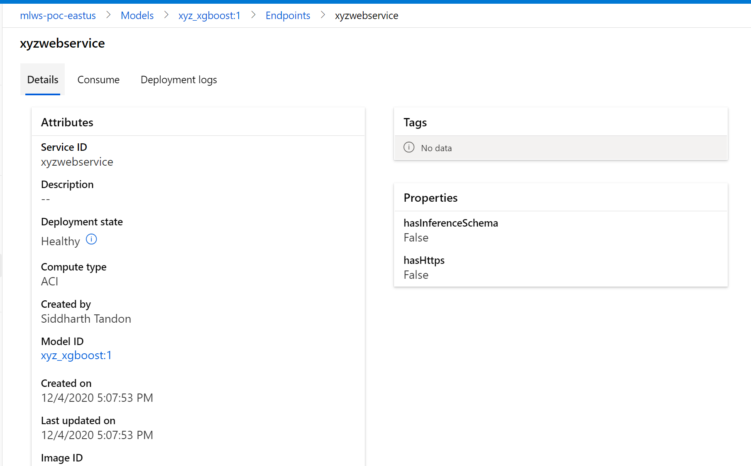
Azure ML Web Service
Deployed the model on Azure ML

